Slide 1

Tutorial
SDM 366 Optimal Control and Estimation
Southern University of Science and Technology

Slide 2
Outline
Introduction
Installation in Windows System
Simulation Example

Slide 3
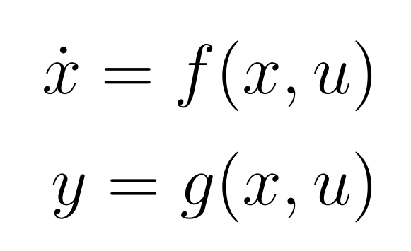
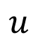
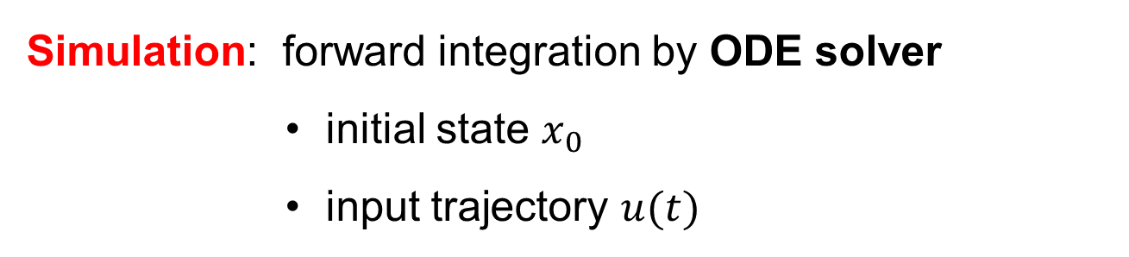
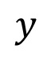
Introduction
Dynamic System
Ordinary Differential Equations
$$u$$
System
$$y$$
Simulation: forward integration by ODE solver
initial state $x_{0}$
input trajectory $u(t)$

Slide 4
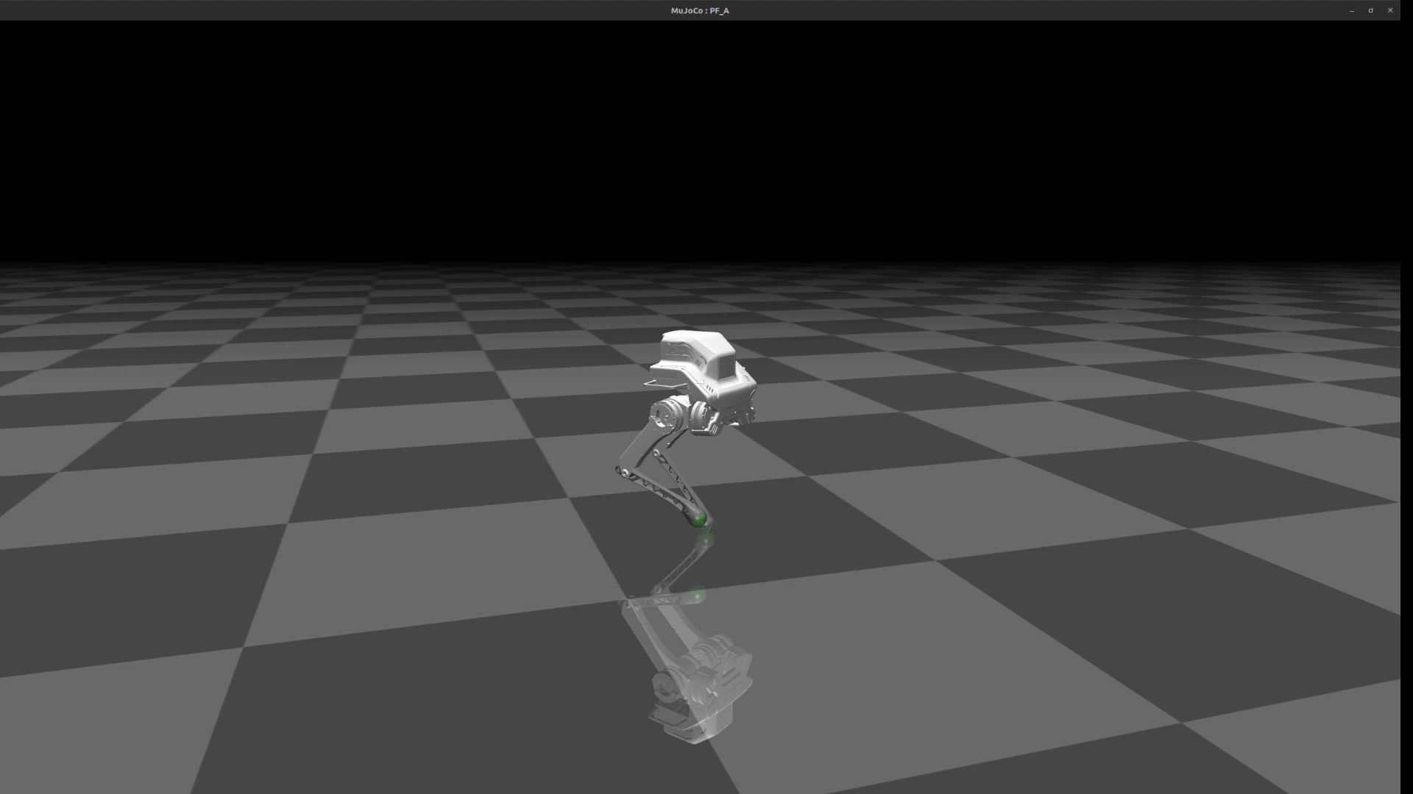
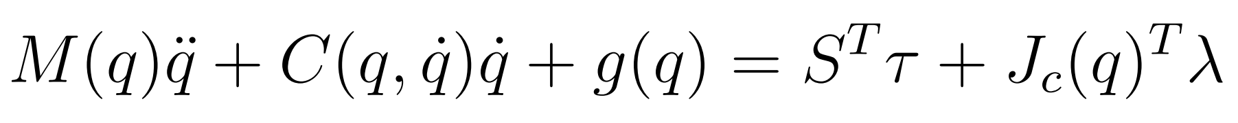
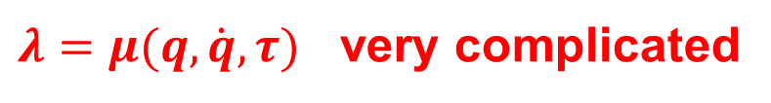
Introduction
Multi-Rigid Body Dynamics
General Coordinate
Joint Torque
Contact Force
$$x_{0}=\left(q_{0},{\dot{q}}_{0}\right), u\left(t\right)=τ\left(t\right), λ=?$$
$λ=μ(q,\dot{q},τ)$ very complicated
Difference between different simulators lies in how to characterize contact dynamics.

Slide 5
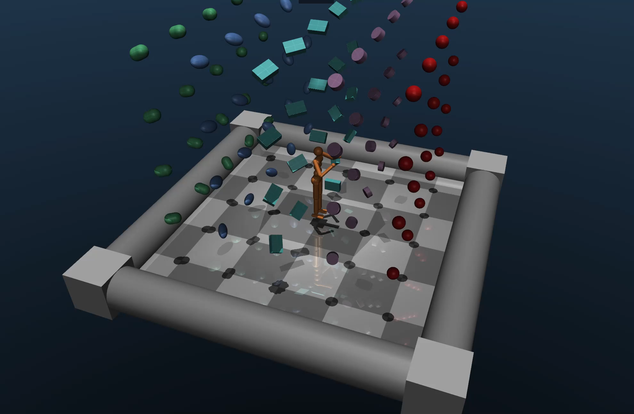
Introduction
DeepMind, Google

Slide 6
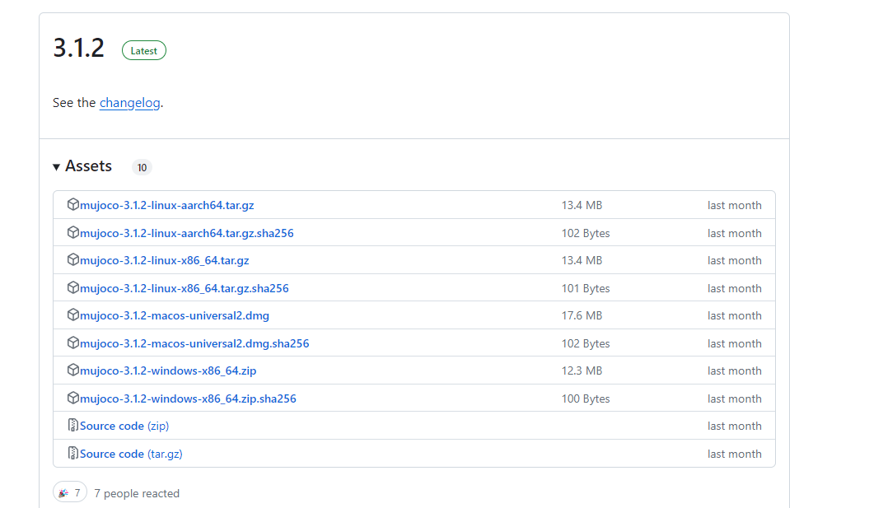
Demo C++ version
Download C++ version
Official web https://github.com/google-deepmind/mujoco/releases

Slide 7
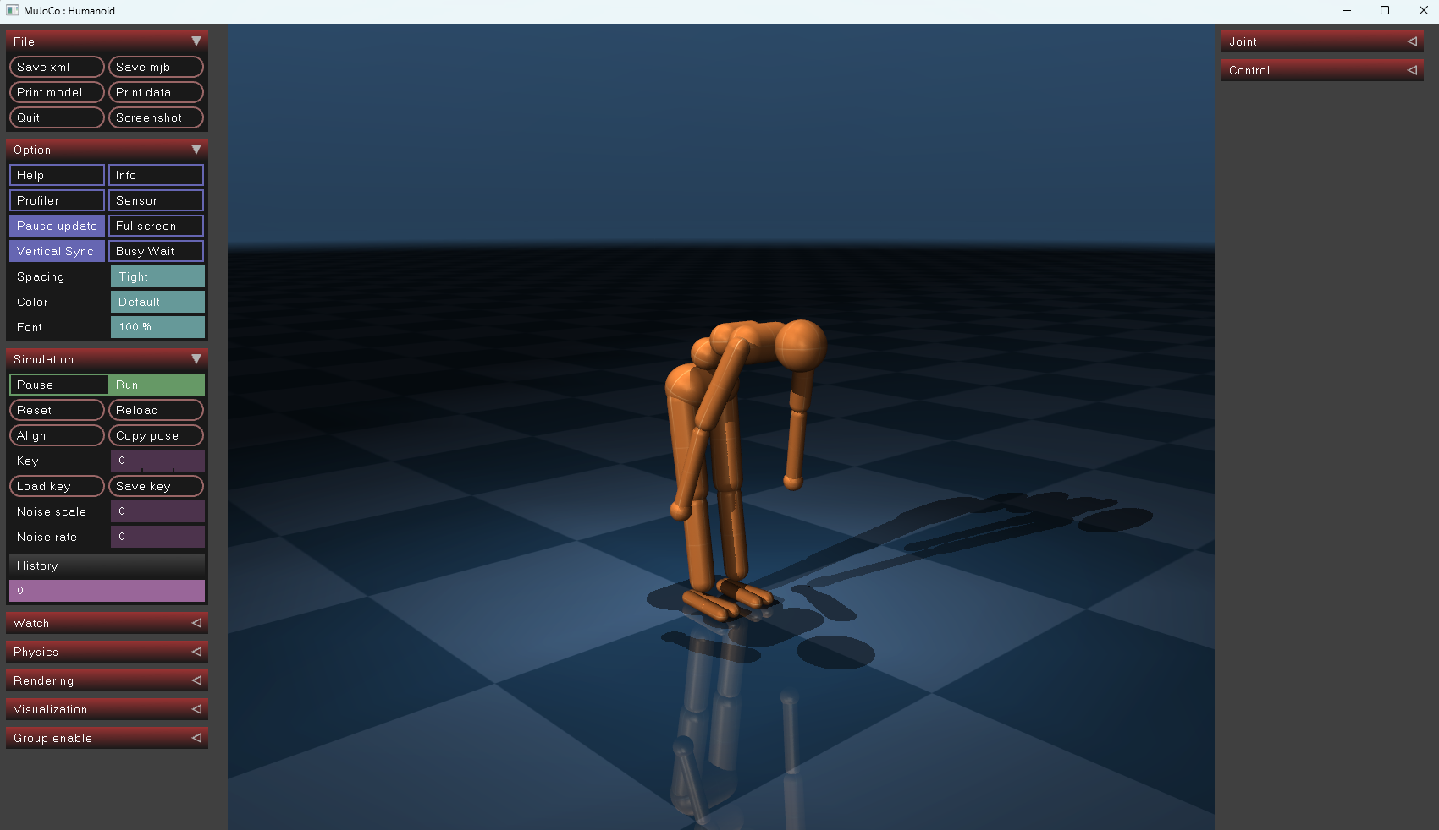
Demo C++ version
Double click on mujoco-3.1.2-windows-x86_64\bin\simulate
Load model file mujoco-3.1.2-windows-x86_64\model\humanoid.xml

Slide 8
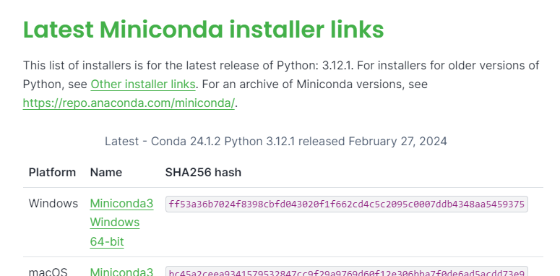
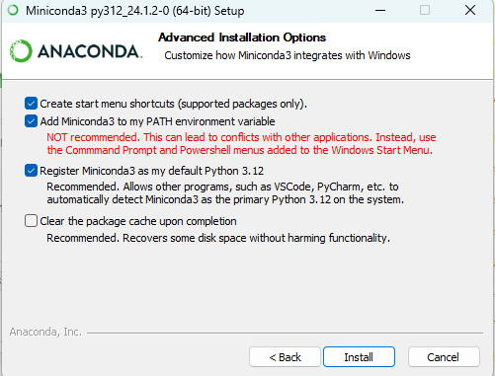
Installation in Windows System (Python)
Install Miniconda
https://docs.anaconda.com/free/miniconda/index.html
Add to PATH environment variable

Slide 9
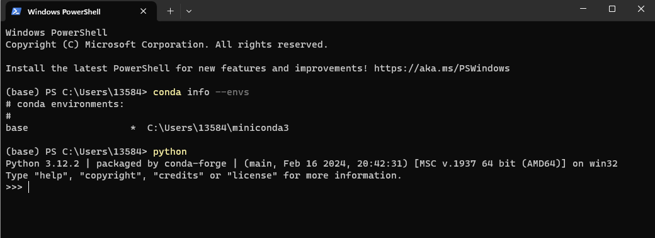
Installation in Windows System (Python)
Test Python3 and check conda env: Search Powershell in Windows and open it
> conda info –-envs
> python

Slide 10
Installation in Windows System (Python)
Install MuJoCo
> conda install mujoco
Install Pinocchio
> conda config --add channels https://mirrors.ustc.edu.cn/anaconda/pkgs/free/
> conda config --add channels https://mirrors.ustc.edu.cn/anaconda/pkgs/main/
> conda config --add channels https://mirrors.ustc.edu.cn/anaconda/cloud/conda-forge/
> conda config --set show_channel_urls yes
> conda install Pinocchio

Slide 11

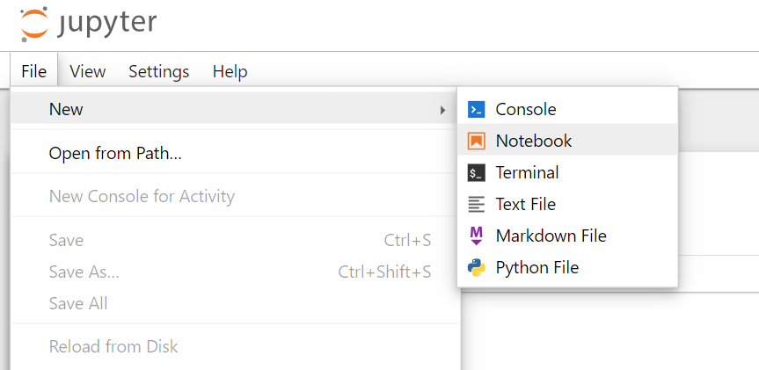
Installation in Windows System (Python)
Install Jupyter notebook
> conda install jupyter notebook
Start Jupyter notebook
> jupyter notebook

Slide 12
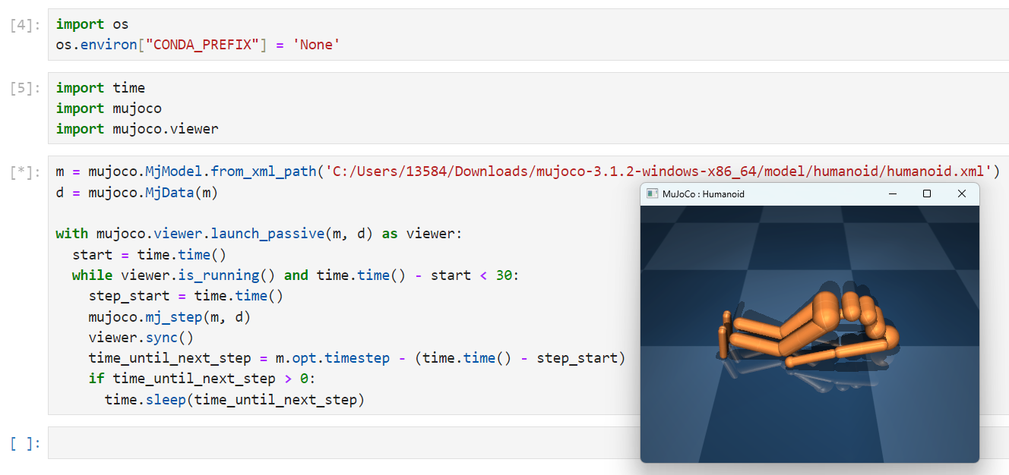
Simulation Example

Slide 13
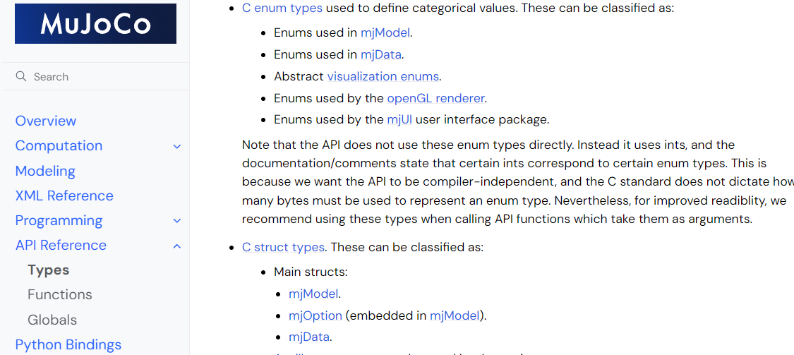
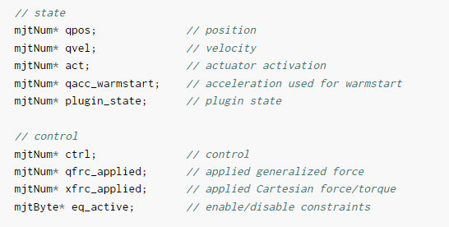
Simulation Example
Access MuJoCo data https://mujoco.readthedocs.io/en/stable/APIreference/APItypes.html

Slide 14
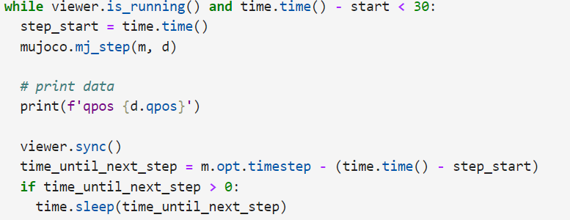
Simulation Example
Access MuJoCo data https://mujoco.readthedocs.io/en/stable/APIreference/APItypes.html

Slide 15
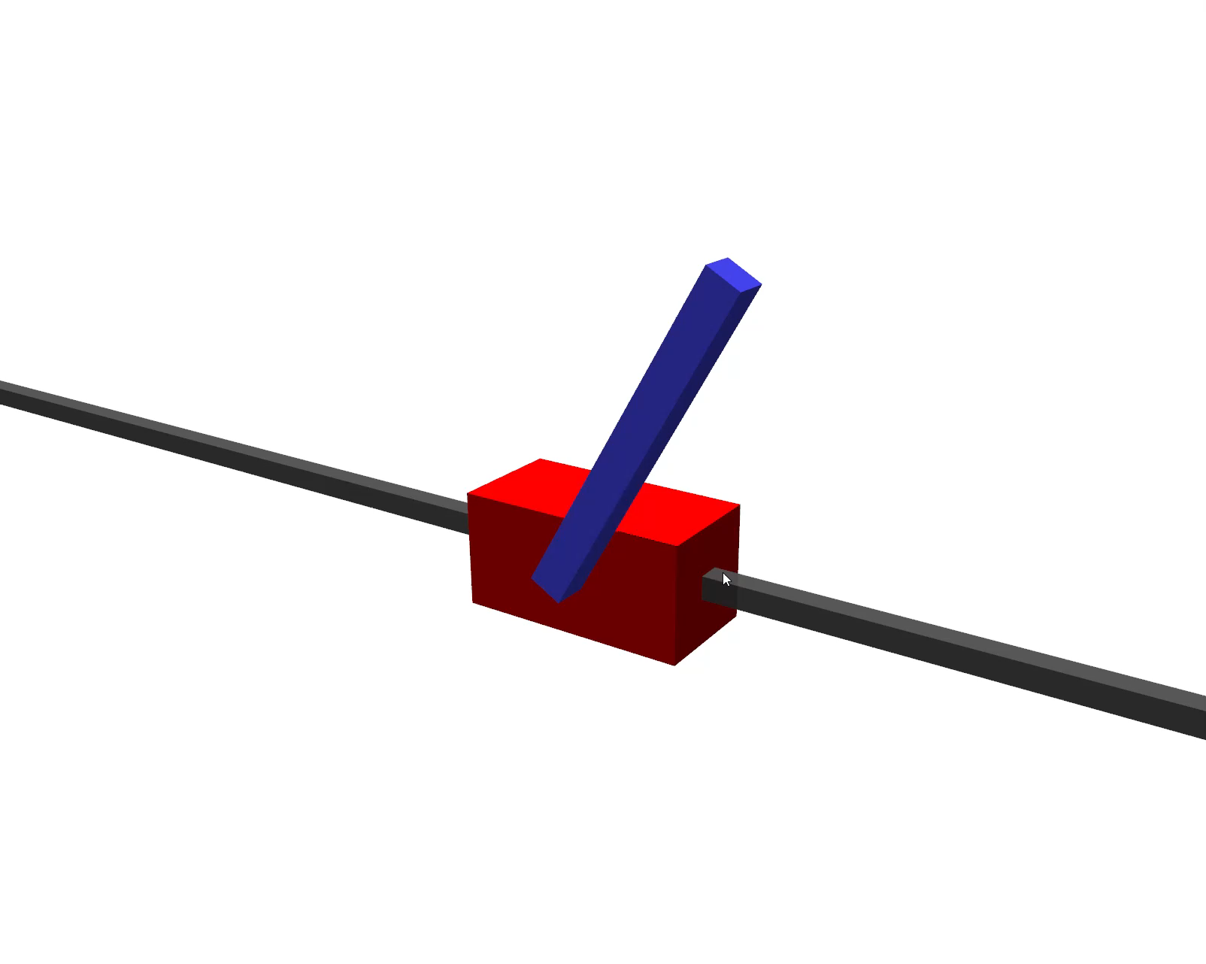
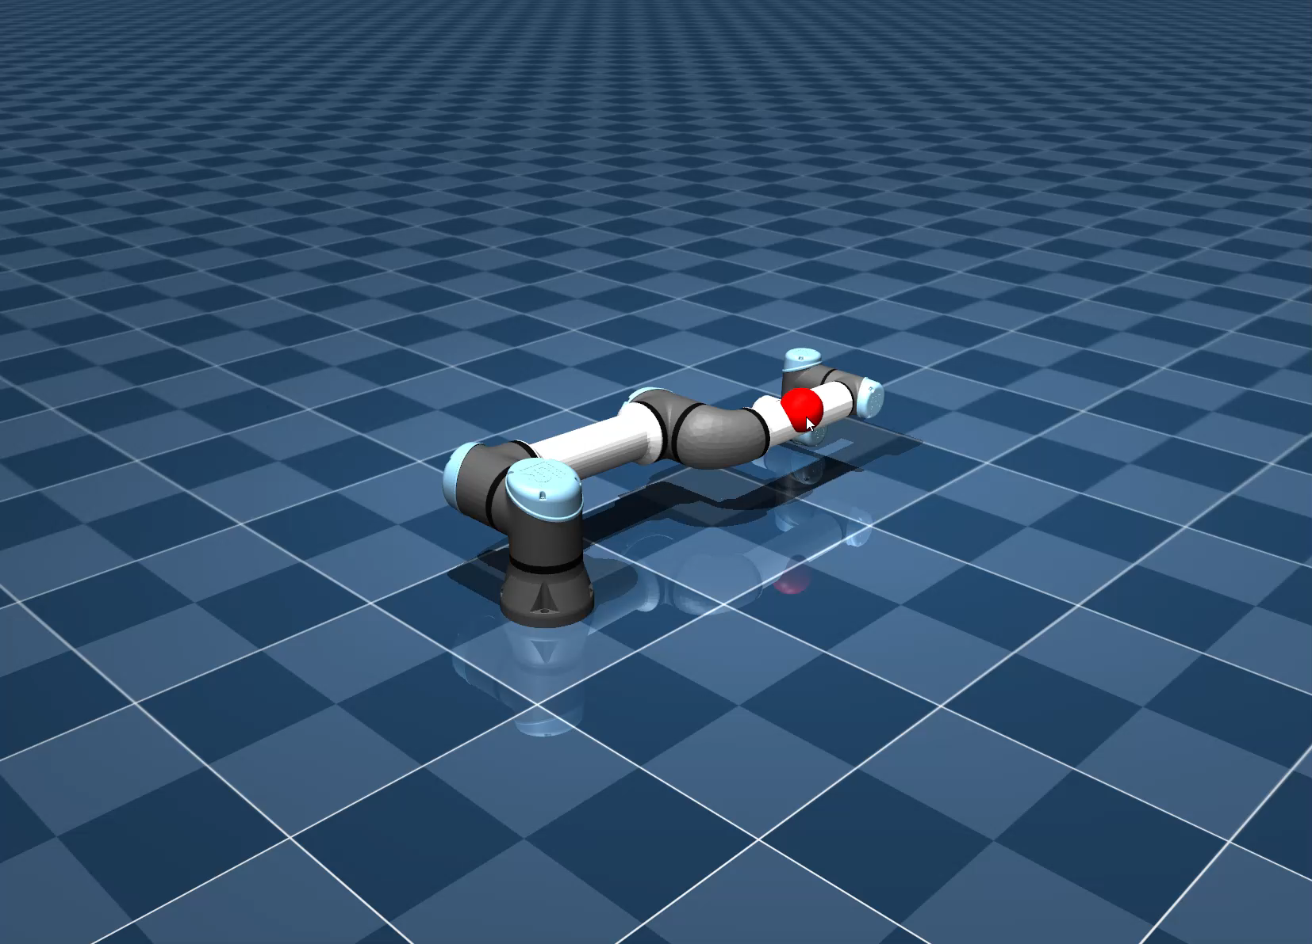
Simulation Example
Robot Arm
Inverted Pendulum

